Slide 1
Library Level Patron Notification Logos
Yoel Kortick
Senior Librarian

Slide 2

  Introduction
  For example
  The results
Agenda

Slide 3
Introduction

Slide 4
Introduction
Institutions can configure Alma so that letters that aggregate information from multiple libraries, such as Borrowing Activity Letter, Courtesy Letter, Ful Requests Report Letter, Ful Overdue And Lost Loan Notification Letter, etc. will be aggregated and sent per library.
For details regarding this feature see
  Movie: Library Level Patron Notifications
  Presentation: Library Level Patron Notifications.pptx
We will now show that it is also possible to have separate letter logos per library

Slide 5
The setup

Slide 6
The setup
Libraries can upload logos to be displayed on letters when a single library is selected in the Configuration menu (Configuration Menu > General > User Interface Settings > Alma Logo and Color Scheme).
This is in addition to being able to upload logos when the institution is selected in the Configuration menu.

Slide 7
The setup
When logos are defined on both the institution and the library levels, the logo displayed on the letter is determined as follows:
  If the organization unit is Library, and a library logo exists for that library, the library logo is displayed.
  If organization unit is Library and no library logo exists for that library, the institution logo is displayed.
  If organization unit is Institution, the Institution logo is displayed.

Slide 8

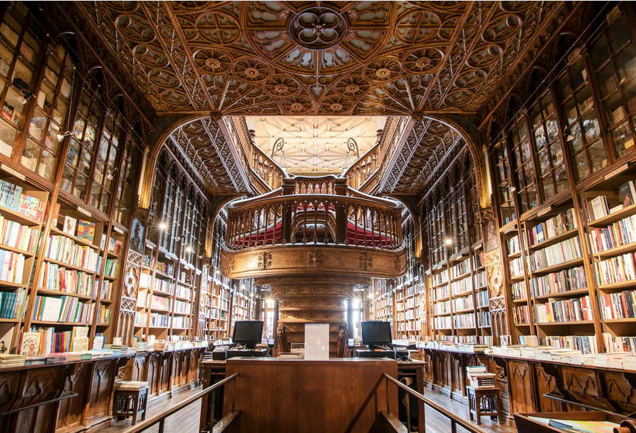
The setup
In our example we will use this for the Main Library:
https://www.pexels.com/photo/books-in-black-wooden-book-shelf-159711/
We will use this for the Library and Information Science Library:
https://www.pexels.com/photo/assorted-books-on-shelf-1290141/

Slide 9
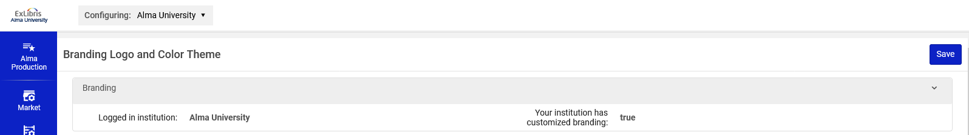
The setup
Access the logos at "Configuration > General > User Interface Settings > Alma Logo and Color Scheme"
On the top choose a specific library instead of the institution
Here we will choose a library instead of the institution

Slide 10
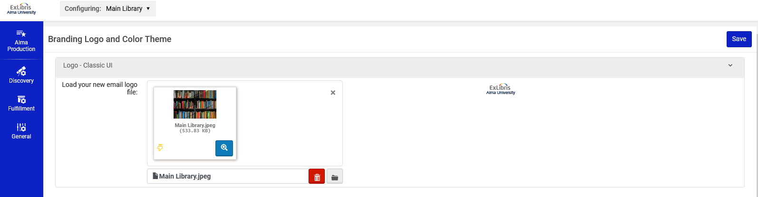
The setup
Here we have chosen "Main Library" and the corresponding logo.

Slide 11
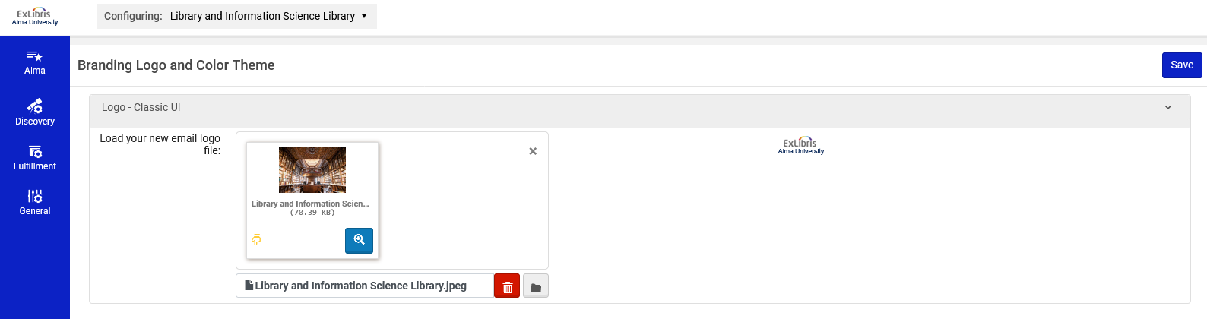
The setup
Here we have chosen "Library and Information Science Library" and the corresponding logo.

Slide 12
For example

Slide 13
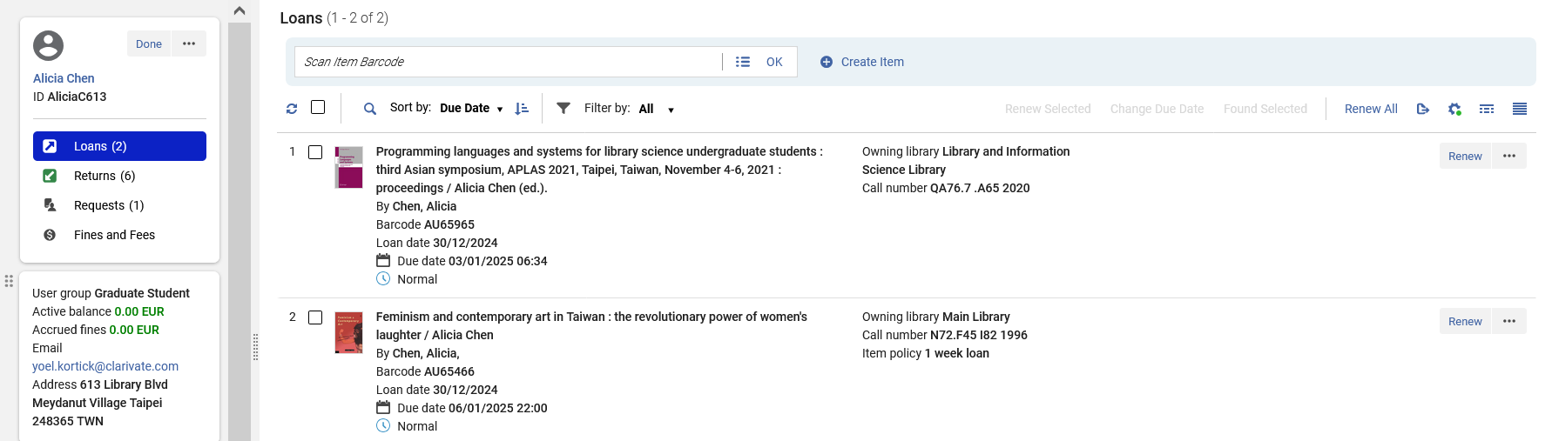
For example
Patron Alicia Chen has two items on loan: One in the "Main Library" and one in the "Library and Information Science Library"

Slide 14
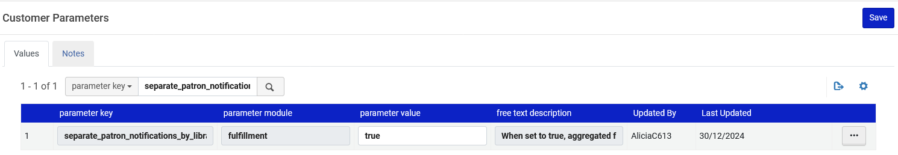
For example
At "Configuration > Fulfillment > General > Other Settings" the Parameter "separate_patron_notifications" is set to "true". This means that separate patron notifications are sent per library, thereby enabling a logo per library.

Slide 15
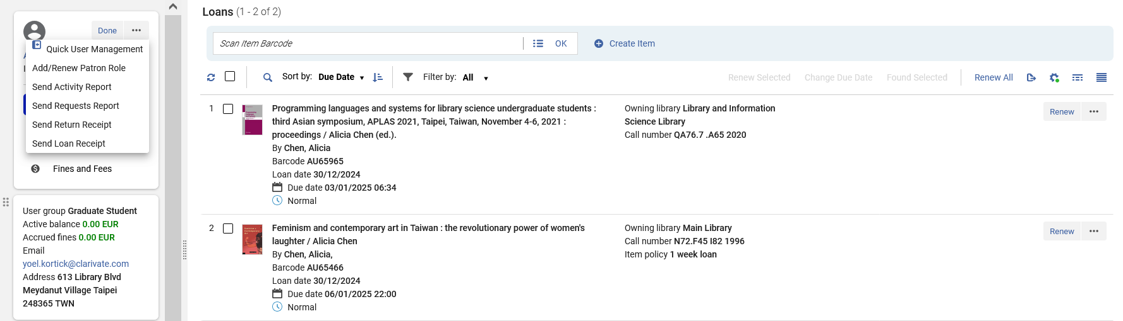
For example
The borrowing activity letter is sent to patron Alicia Chen

Slide 16
The results

Slide 17
The results
Alicia Chen received two letters:
  One for loan activity in the Main library
  One for loan activity in the Library and Information Science Library.
Each letter has the appropriate logo.

Slide 18
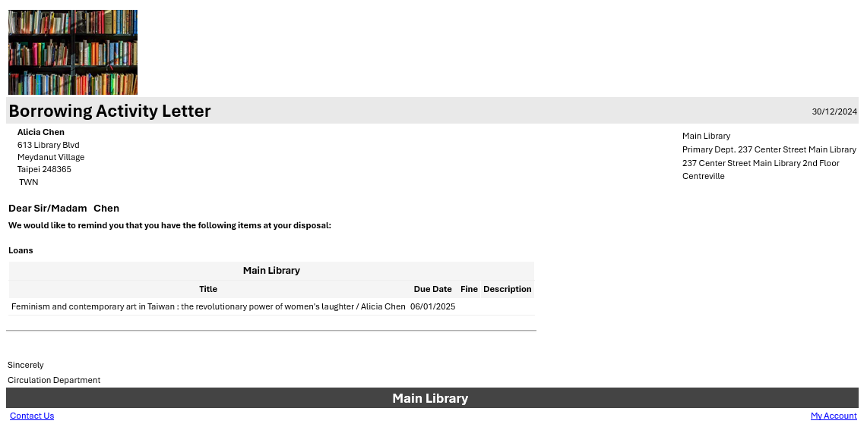
The results
The letter to Alicia Chen for the Main Library uses the logo for the Main Library

Slide 19
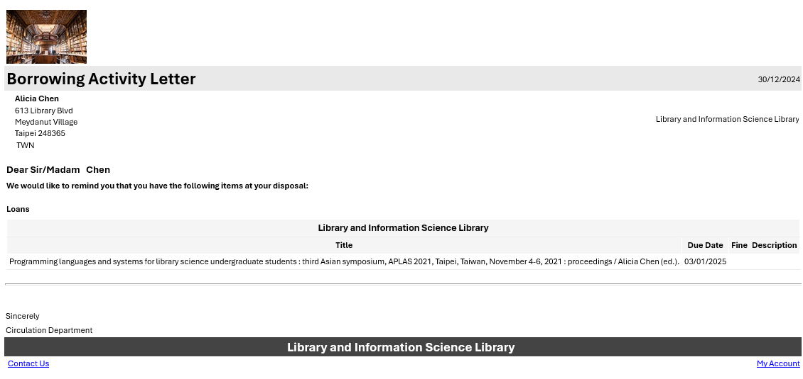
The results
The letter to Alicia Chen for the Library and Information Science Library uses the logo for the Library and Information Science Library

Slide 20
xxx@exlibrisgroup.com

